Slide 1
Burgundy
COS 214 Final Project
Group 24
Lerato Gololo · Brenden van der Mescht · Siyamthanda Ndlovu Katlego Zondo · Sechaba Ntshehi

Slide 2
Burgundy
Functional Requirements
Chef should be able to :
Receive orders from waiters
Use order to construct meals
Plate food to be sent to waiter
Observe customer satisfaction
Manager should be able to :
Assign tables to customers
Build tables which can hold a maximum of four customers
Observe customer satisfaction
Customer should be able to :
Be assigned to a table
Create an order and then place it
Specify ingredients and remove or add to the order prior to it being sent to the kitchen
Decide on payment method
Receive their order and eat it
Waiter should be able to :
Be assigned a table
Take customer orders to the kitchen
Receive the meals from the kitchen and deliver them to the customers
Create bills and send them to customers
Observe customer satisfaction for the customers at their table

Slide 3
Burgundy
Mediator
Waiters take orders between floor and kitchen
Chain of Responsibility
An order has to go through a chain of chefs that may each handle the order
Design Patterns
Memento
Customer may revert back their order to a previous version
Decorator
Each customer may customise their burger burger to only include ordered ingredients
Strategy
Customer may pay the bill by paying on their own, splitting it or by opening a tab
Builder
Should a group of more than four customers enter, the manager has to build a table for them
State
A table may either be unoccupied, occupied, dirty or have its bill paid
Observer
The floor staff needs to observe the satisfaction of tables in the restaurant
Factory Method
The drinks chef may create either a juice, water or soft drink depending on the order
Iterator
When the customers are splitting a bill, we iterate through the customers to get their contribution

Slide 4
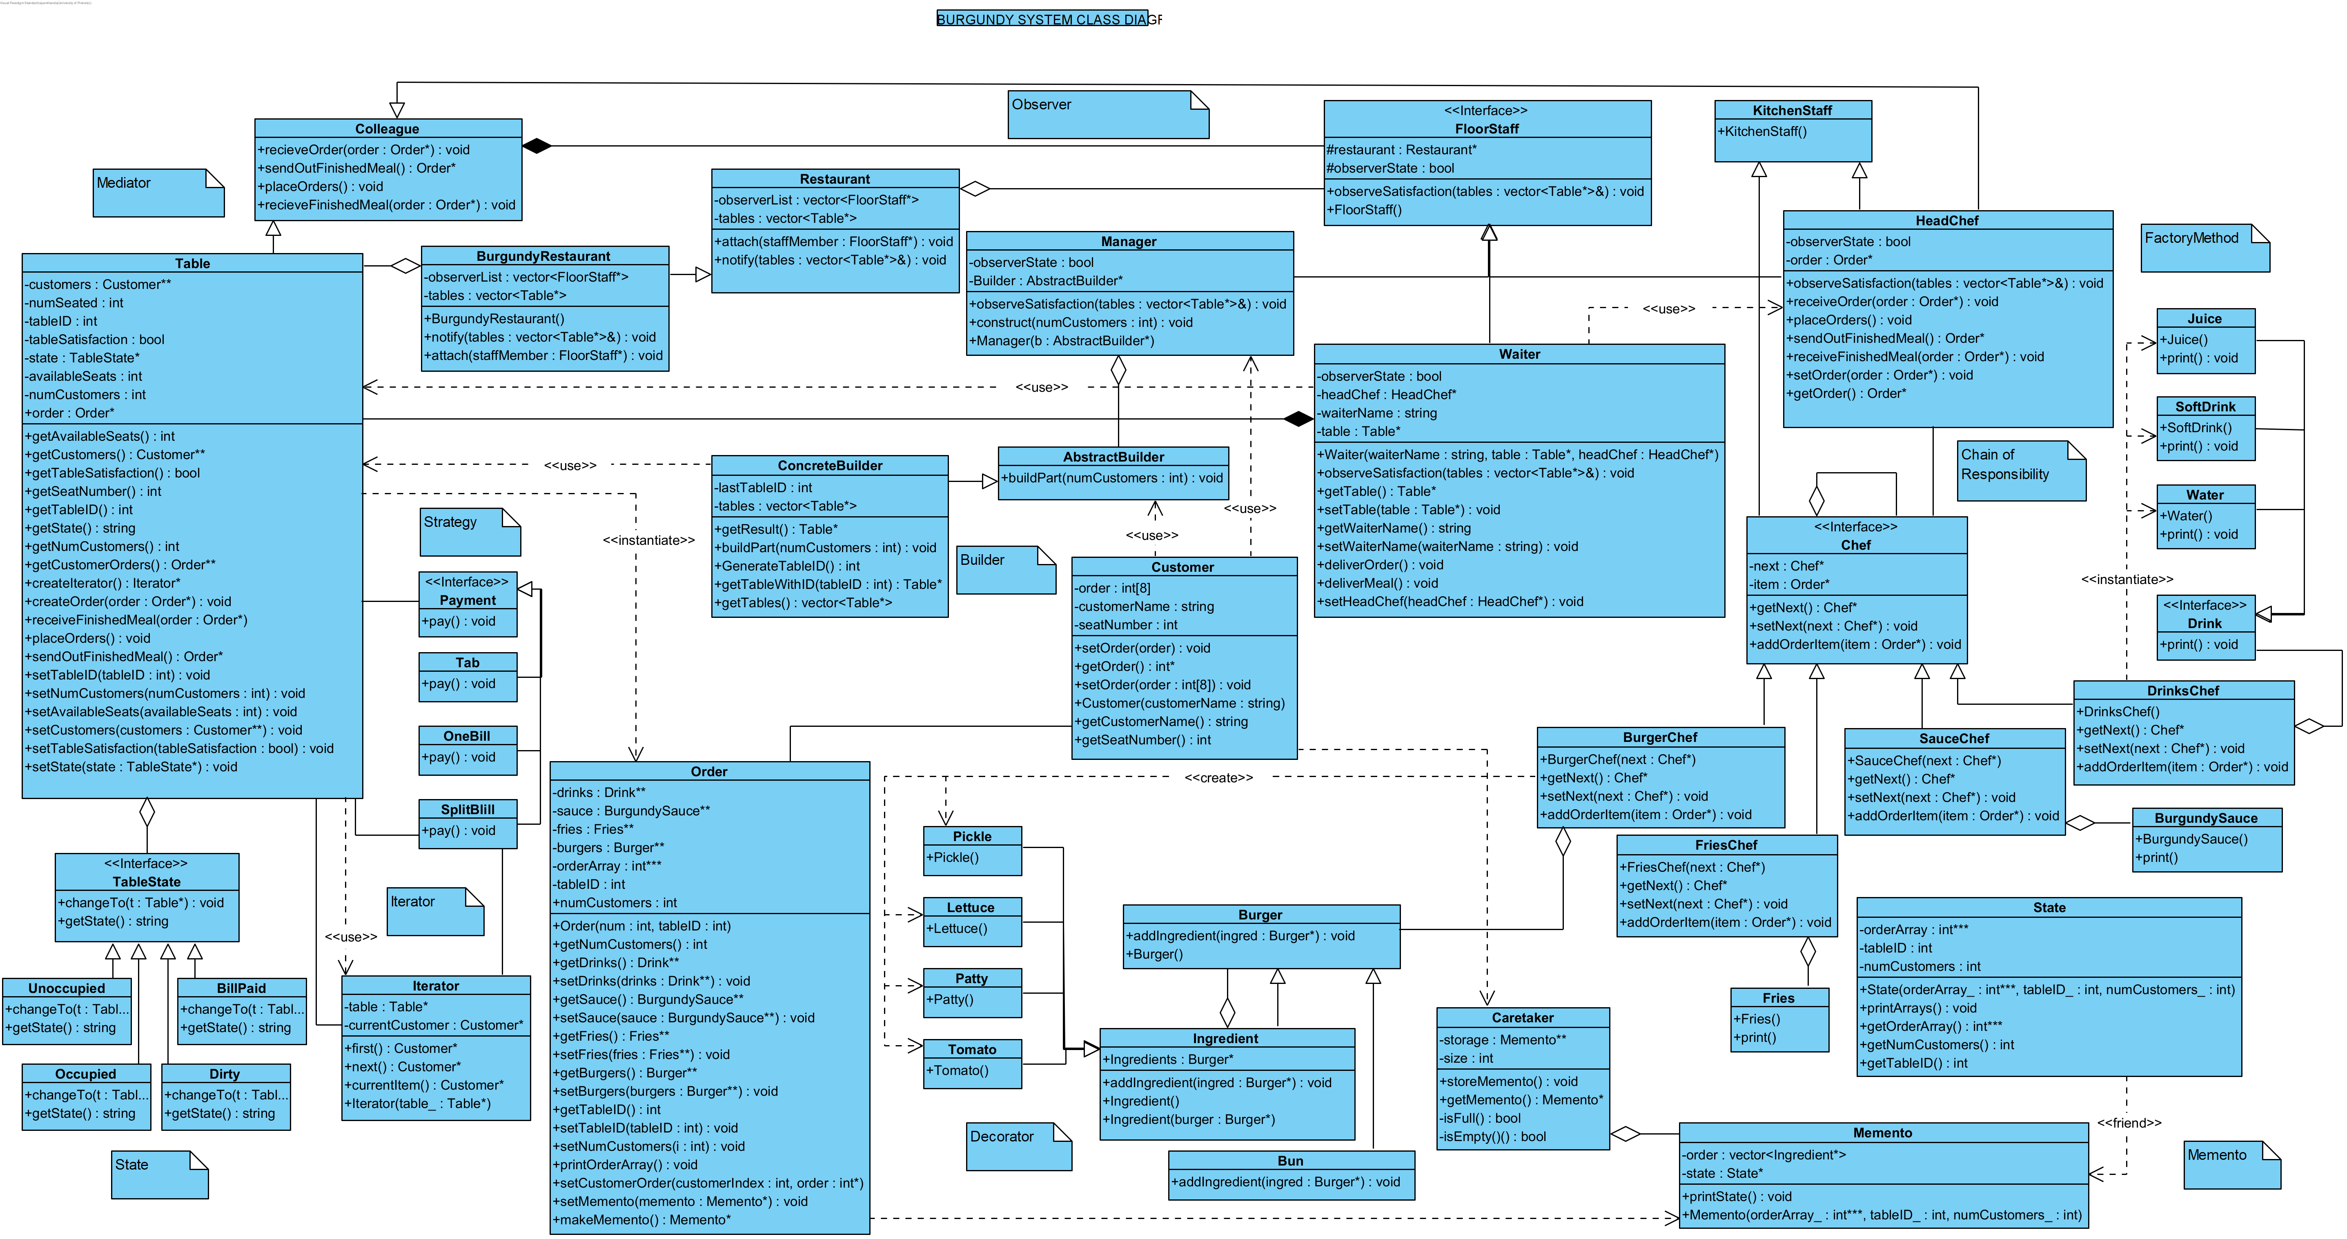
Burgundy Class Diagram

Slide 5
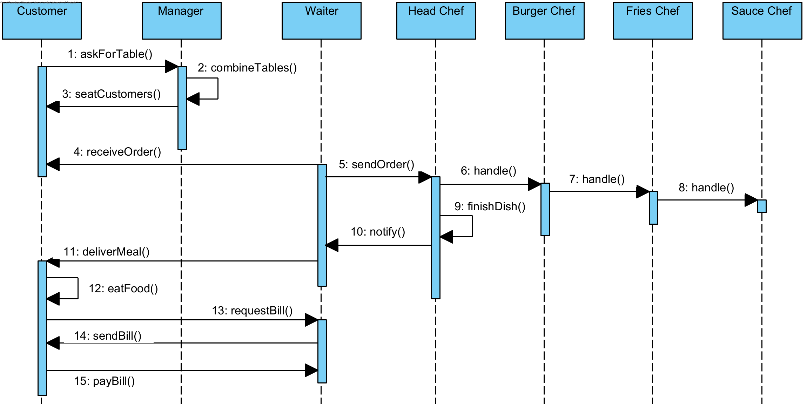
Burgundy Seqeunce Diagram

Slide 6
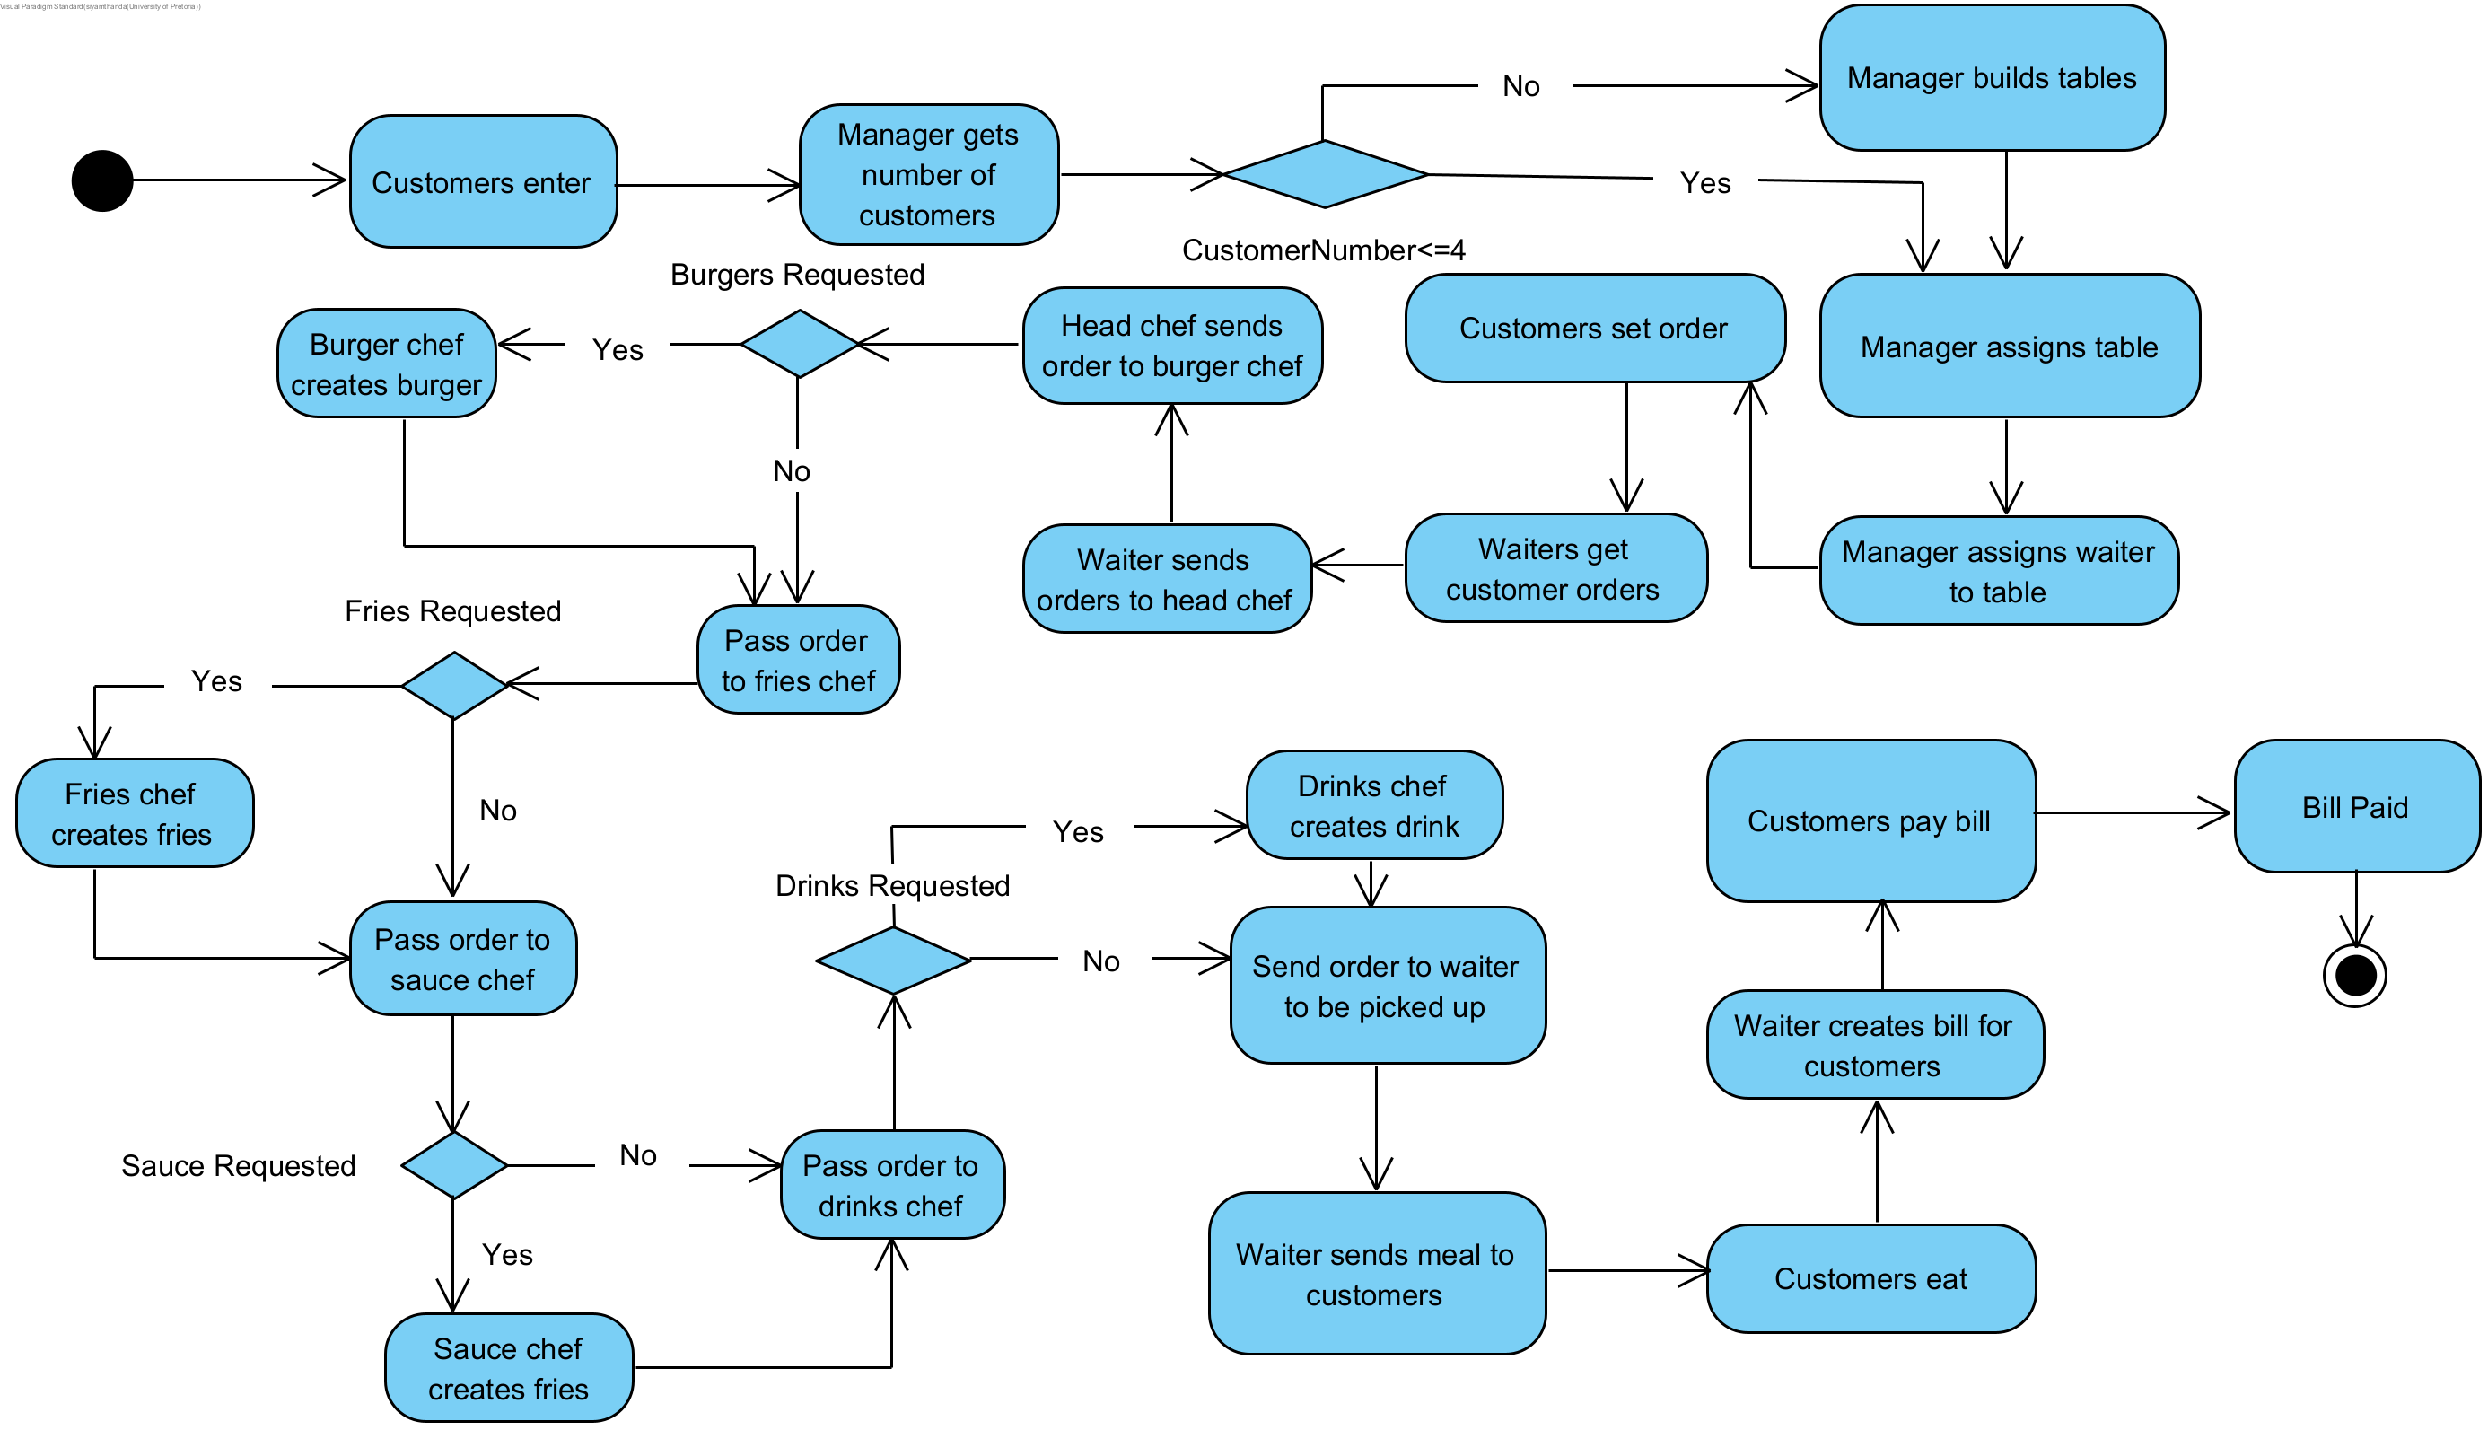
Burgundy Activity Diagram

